Slide 1
Mutual Fund Performance Evaluation with Active Peer Benchmarks
----David Hunter, Eugene Kandel, Shumel Kandel, Russ Wermers
Presented by Qi Yang
Instructed by Phil Dybvig

Slide 2
1
INTRODUCTION
2
MOTIVATING APB
3
DATA & EMPIRICAL MODELS
5
6
RESULTS
CONCLUSIONS

Slide 3



introduction

Slide 4
Basic Questions
Whether active fund managers deliver superior performance?
Does active management produce persistent superior investment performance?

Slide 5
Evolution of active management evaluation
1968
Simple Sharpe Ratio Comparisons to Jensen’s α using single risk factor
1993
French Fama’s Three Factor Model
1997
Carhart Added Momentum as the Fourth Factor

Slide 6
Problems in evaluation
Presence of similar strategies among funds.
Produce correlated residuals from commonly used models.
Difficult to get data.
Inaccessibility to portfolio holdings data about commonalities in practice.
Reduce the power of such models to separate skilled managers.
Infrequently disclosed portfolio holdings for mutual funds.

Slide 7
Active peer benchmarks
An additional benchmark from the return on the group of funds to which a given fund belongs, as each fund manager chooses the peer group with which it intends to compete. (e.g. Funds benchmark against a same benchmark market index.)
Reason: By choosing actively manage fund that against a particular index, the manager implicitly chooses from a set of strategies used by the set of active funds that benchmark against the same index.

Slide 8
Active peer benchmarks
Fund Returns
Investment Objective
Simple
Easily Implementable

Slide 9
Identify the best active strategies.
Capture commonalities dynamically.
Allowes evaluation of the performance of any fund.
Tradable Assets

Slide 10
Nine style categories of funds
Growth
Value
Total
Total
Value
Growth
Total
Value
Growth
Large-Capitalization
Mid-Capitalization
Small-Capitalization

Slide 11
Clarifications
The APB return for the following regressions are equally-weighted average across all funds that are available for investment in that category at the beginning of that month.
To make the APB a realistic baseline investment, we include only no-load funds in our analysis to minimize any costs of investing and rebalancing among a potentially large group of funds in a particular category.

Slide 12
Motivating apb

Slide 13
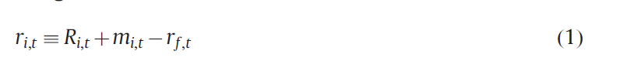
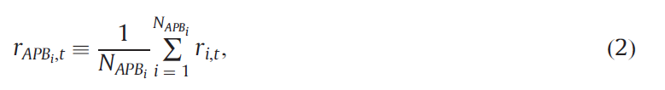
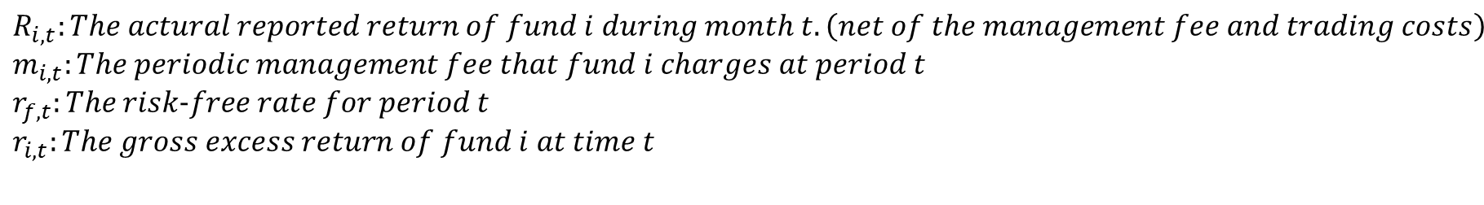
The econometric model
$$R_{i,t}:The actural reported return of fund i during month t.\left(net of the management fee and trading costs\right)$$
$$m_{i,t}:The periodic management fee that fund i charges at period t$$
$r_{f,t}:The risk−free rate for period t$
$$r_{i,t}:The gross excess return of fund i at time t$$
$$r_{{APB}_{i},t}:The average gross excess return of the active peer group of funds to which fund i belongs.$$
$$N_{{APB}_{i},t}:The number of funds in the APB$$

Slide 14
THE baseline model
$$We assume just one risk factors here for simplicity.$$
$L_{t}:A random zero−mean variable \left(an unpriced risk factor\right).$ $ω_{i,t}:An independent and identically distributed \left(across funds\right) error term.$

Slide 15
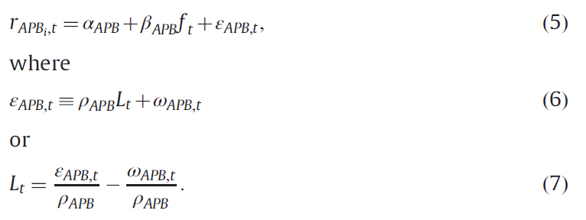

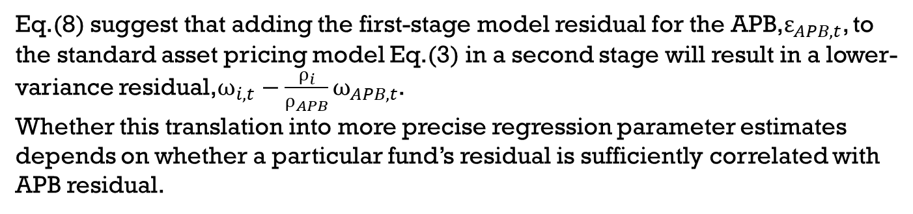
The APB model is undertaken to increase the precision of the estimator of $α_{i}$.
Substituting Eq.(7) into Eq.(3), the model for a single fund is:
Eq.(8) suggest that adding the first-stage model residual for the APB,$ε_{APB,t}$, to the standard asset pricing model Eq.(3) in a second stage will result in a lower-variance residual,$ω_{i,t}−\frac{ρ_{i}}{ρ_{APB}}ω_{APB,t}$.
Whether this translation into more precise regression parameter estimates depends on whether a particular fund’s residual is sufficiently correlated with APB residual.

Slide 16


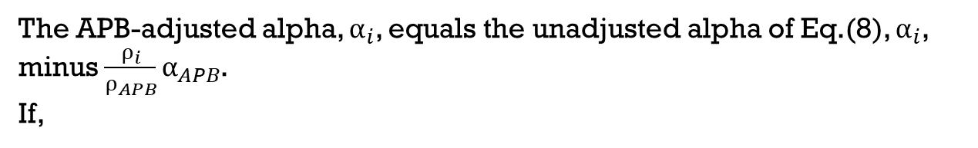
Apb-adjusted alpha model
The APB-adjusted alpha, $α_{i}$, equals the unadjusted alpha of Eq.(8), $α_{i}$, minus $\frac{ρ_{i}}{ρ_{APB}}α_{APB}$.
If,
Then Eq.(9) assigns the manager a zero alpha.

Slide 17
DATA & EMPRICAL MODELS

Slide 18
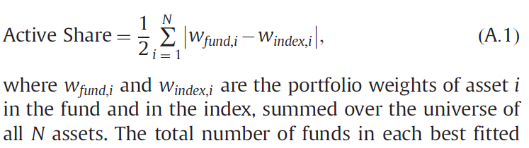
Fund categorization
Best Fit Benchmark

Slide 19
Large-Capitalization
Russell 1000 Value
Russell 1000
Mid-Capitalization
Russell Midcap Value
Russell Midcap
Small-Capitalization
Russell 2000 Value
Russell 2000
Russell 1000 Growth
Russell Midcap Growth
Russell 2000 Growth

Slide 20
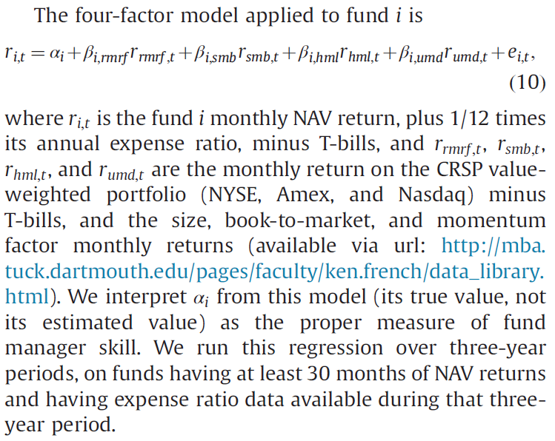
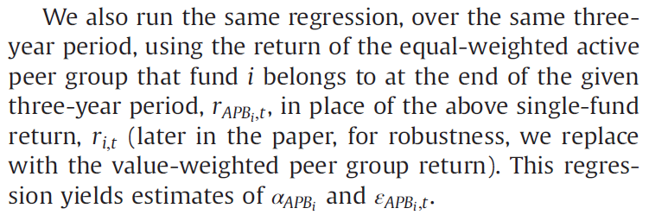
models
Baseline Model

Slide 21
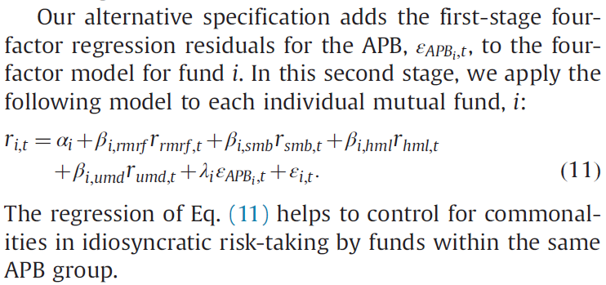
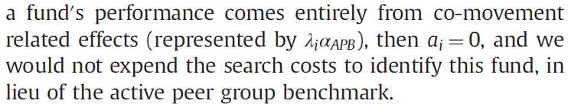
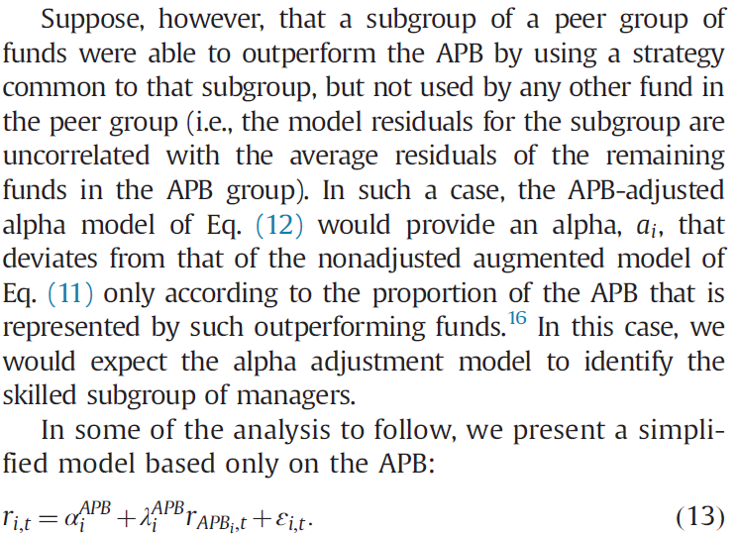
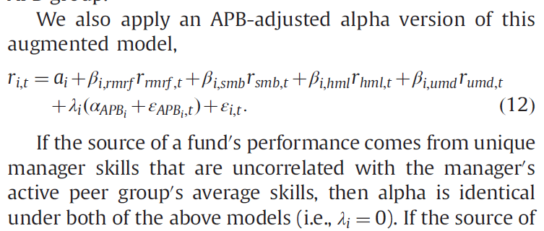
Augmented Model

Slide 22
results

Slide 23
Criteria
Fund return data ranges from 1980 to 2009.
Each category group should have at least 5 funds.
For every 3-year period, a fund must have at least 30 or more monthly return observations to be qualified to be selected in a group.
Estimates that are significant at two-tailed 90% confidence level are presented in bold, significant at 95% level are presented with one asterisk(*) and significant at 99% level are presented with two asterisk(**).

Slide 24
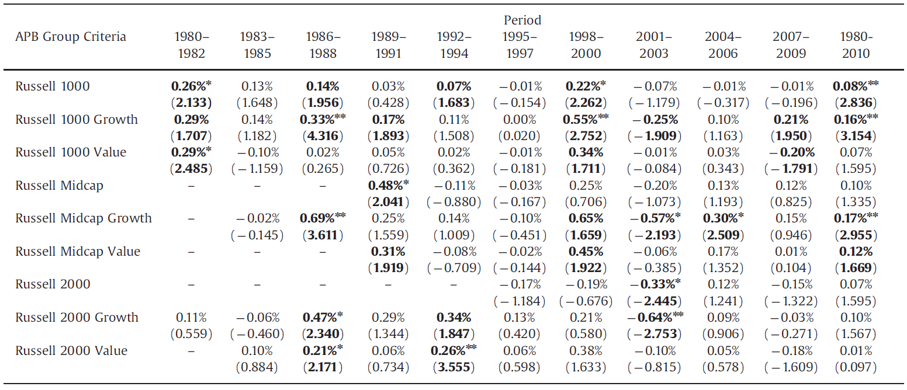
Performance of active group benchmarks
Table 1

Slide 25
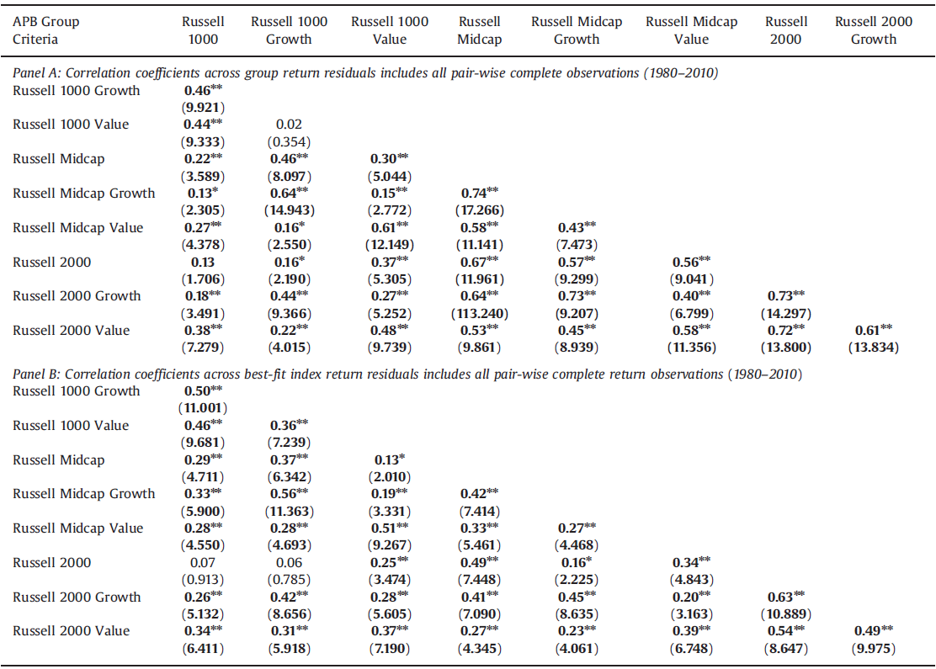
Correlation between apb residuals
Table 2

Slide 26
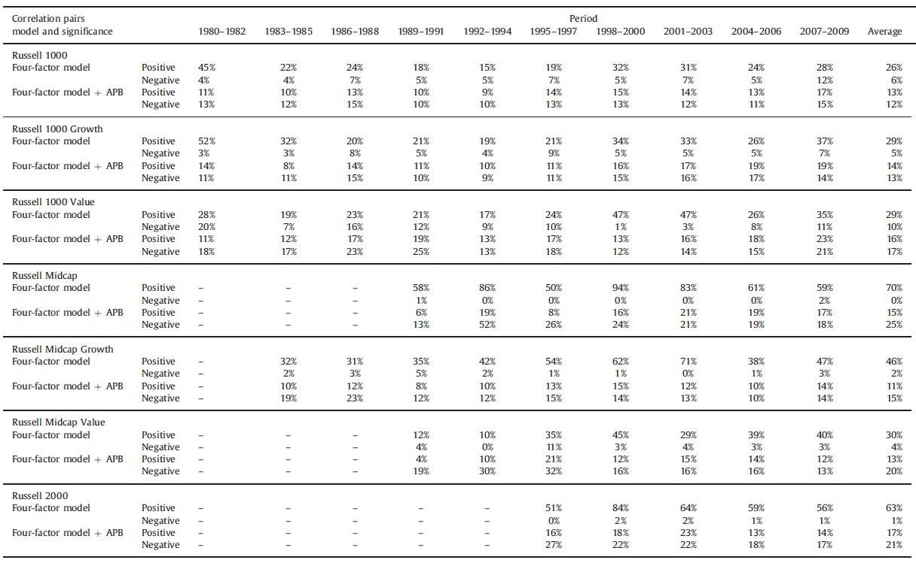
Correlation between individual equity fund residuals
Table 3

Slide 27
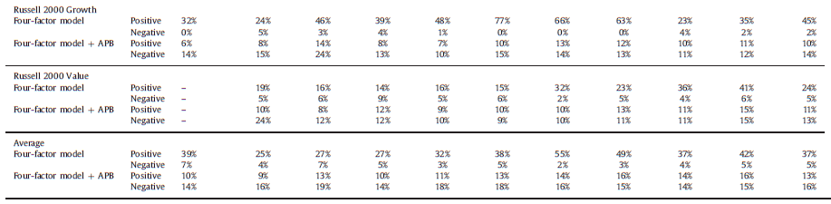

Slide 28
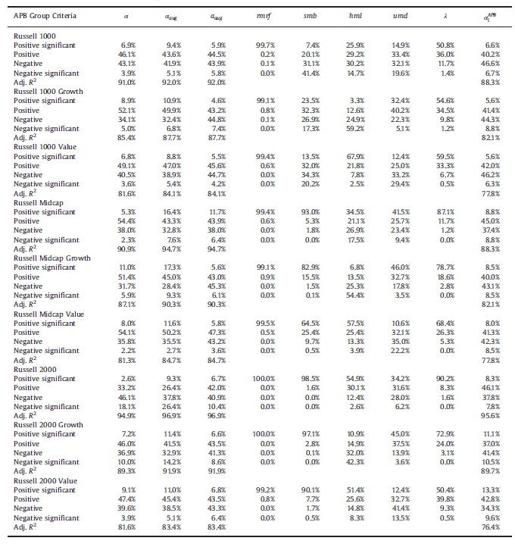
Alpha estimation diagnostics
Table 4

Slide 29
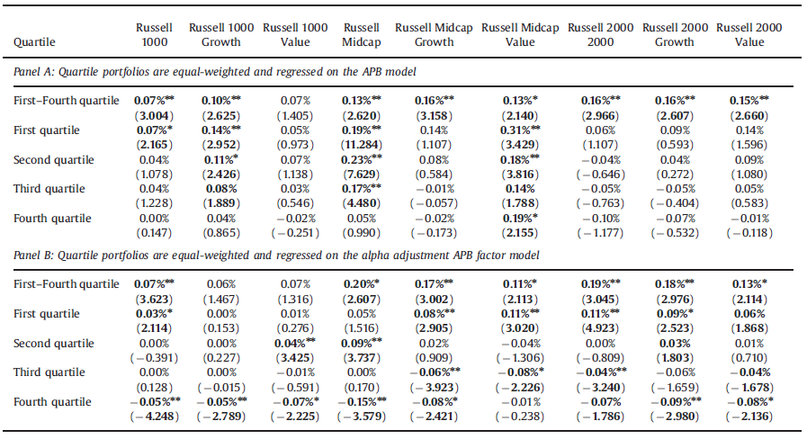
Out-of-sample performance
Pre-expense alpha
Table 5

Slide 30
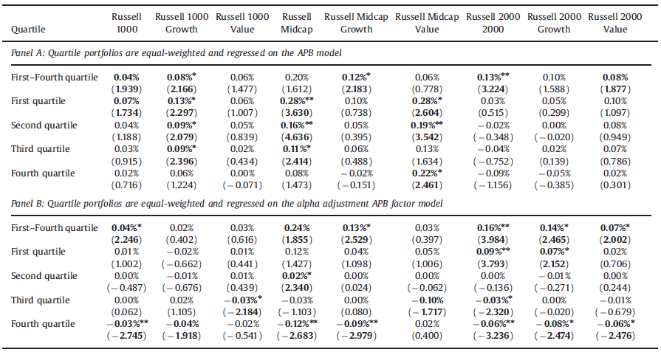
Table 6

Slide 31
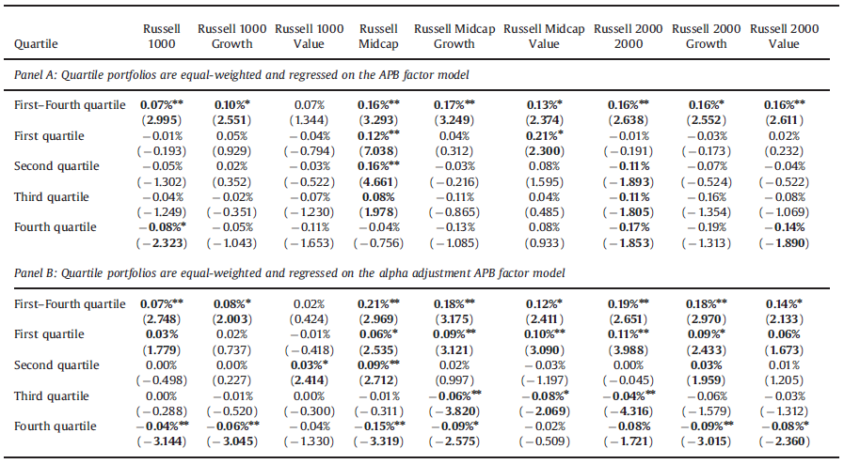
Net return alpha
Table 7

Slide 32
rObustness tests
Adding a passive index to the four-factor model
Adding a liquidity factor to the four-factor model
Value-weighted active peer group benchmarks
Self-designated benchmarks
Form from self-designated investment objectives.
Similar results to those of the APB benchmarks.
Multiple active peer benchmarks
Augment the standard four-factor model with all nine equal-weighted APB factors.
The loss in degrees of freedom from using multiple factors penalizes this model and eliminates any
advantage that it could have over the single APB model.

Slide 33
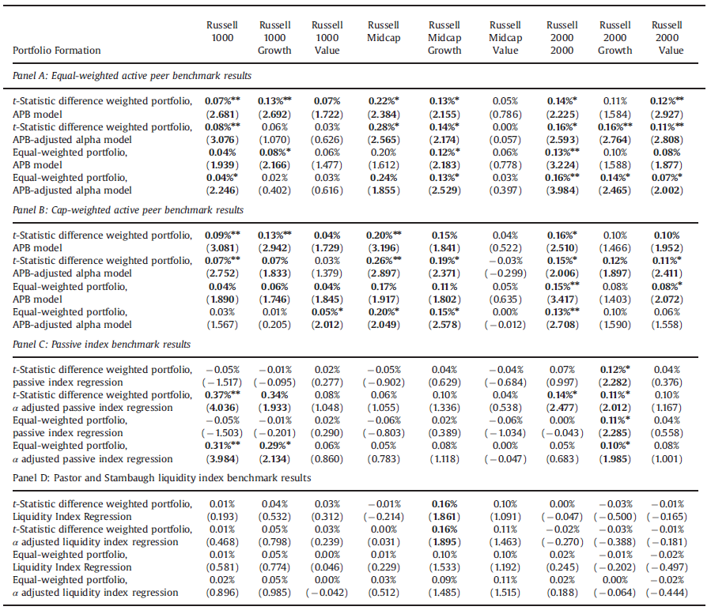
Table 8

Slide 34
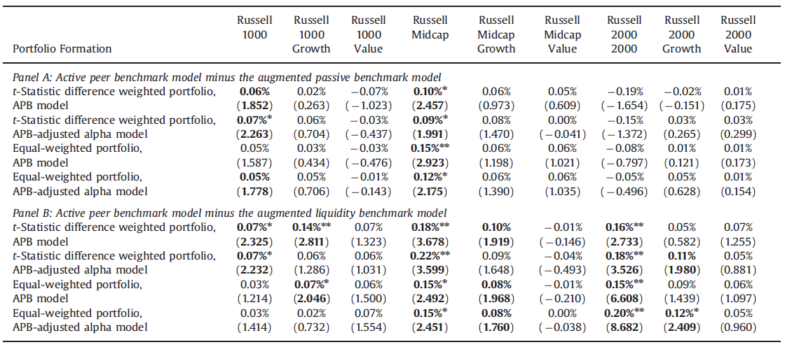
Table 9

Slide 35
Conclusions

Slide 36
Contribution: Propose a conceptually simple and easily implementable way to control for common, unpriced idiosyncratic risks taken by mutual fund.
APB substantially decreases the between-fund residual correlation within a group, when the APB is added to standard factor models.
Funds within one peer group tend not to use strategies that are common to other peer groups.
Added APB benchmark significantly improves the identification of skilled (and unskilled) fund managers within several of the fund groups.

Slide 37

Any questions?

